Slide 1
The 9-Euro-Ticket in Germany

Slide 2
The 9-Euro-Ticket
Was passed by Parlament May 15th 2022
For June, July, August 2022 (continuation unclear)
Ticket ist valid for local and regional Public Transport (commuter train, bus, subway, …), not for long-distance trains

Slide 3
Success of the 9-Euro-Ticket
In June 21 Million Tickets have been purchased
10 Million monthly Passes are automatically changed into a 9-Euro-Ticket
In consequence nearly 40% of the Population has a 9-Euro-Ticket

Slide 4
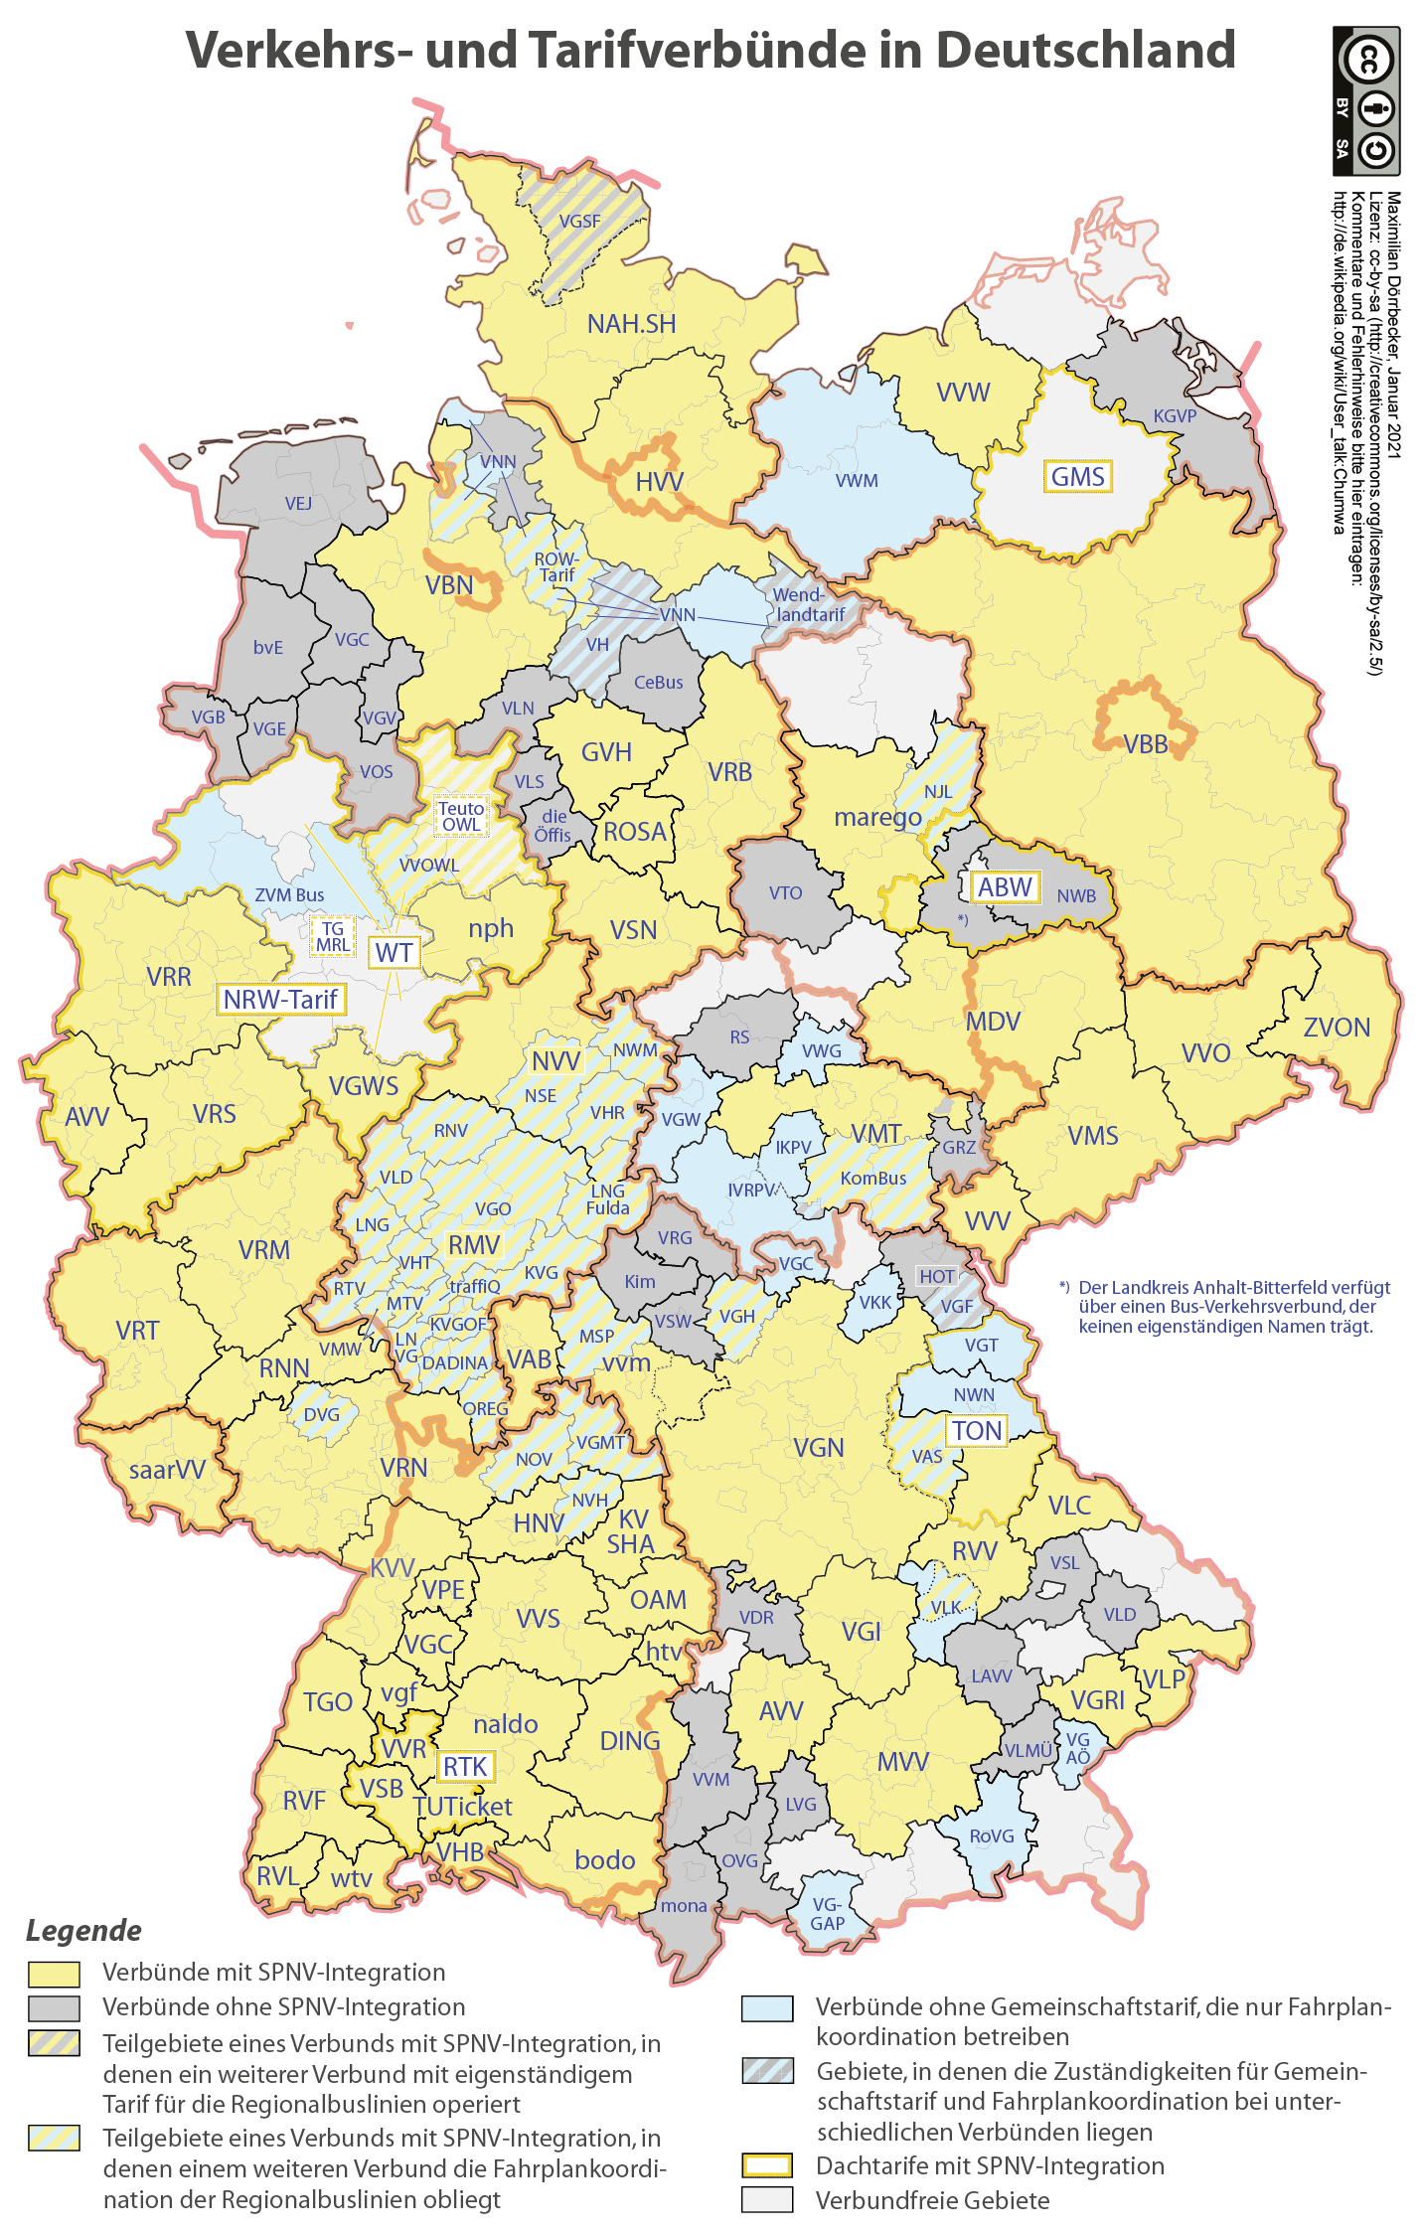
Why ist the Ticket attraktive:
(a) It is cheap
Monthly Pass per regional transport association:
57 – 112 Euro
Price jump if monthly pass covers more than one area

Slide 5
Why ist the Ticket attraktive:
(b) It is easy to use.
Different prices and fare zones in each region
The 9-Euro-Ticket costs the same everywhere. No regional limitations to its use.

Slide 6
Effects on traffic
Rail traffic: +42%
Compared to 2019
Highest increase: 30-300 km

Slide 7
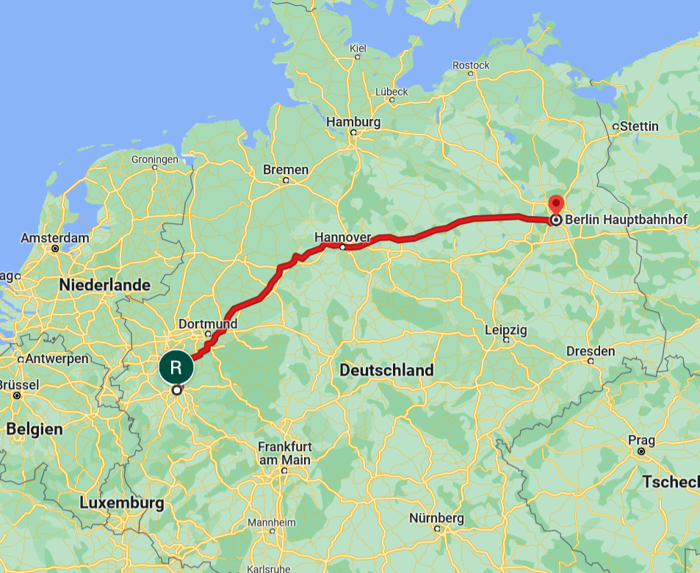
Cologne to Berlin by train
By long distance train (ICE)
4h 20 min
direct connection
By regional train
9h
6 trains, 5 changes

Slide 8
Effects on traffic
Rail traffic: +42%
Compared to 2019
Highest increase: 30-300 km
Local Public transport:
No clear picture yet.
Fare dodging:
Reduced by 50% to 90%
Car traffic: -6%
Fewer traffic jams in 23 of 26 cities

Slide 9
The Ticket shows Problems and Deficiencies
Some trains overcrowded (Especially touristic lines and around Holidays)
  People with impaired mobility have difficulties using the train
  Taking a bike onto train not always allowed
  Lower punctuality
Infrastructure is strained and fails
Workforce is overburdened, high sickness ratio

Slide 10
How high is the Bill?
June, July, August: 2,5 Billion Euro
In one year: 10 Billion Euro

Slide 11
Can the Bill be paid? Ja!
Subsidies detrimental to the Environment:
At least 65 Billion Euro per year
8,2 Billion Euro Tax Reduction for Diesel fuel
6,0 Mrd. Euro Compensation for commuters
3,1 Mrd. Euro Refund for company cars

Slide 12
What happens next?
Continuation of the 9-Euro-Ticket
29-Euro-Ticket / 365-Euro-Ticket
Several Tickets for city / area / country
69-Euro-Ticket
End the Ticket, evaluate it, set up a study group In autumn

